Slide 1
Project Title
Initial Seminar - Presentation Template
Group Members
Students Name Roll #
Students Name Roll #
Students Name Roll #
Students Name Roll #
Name of Supervisor(s):

Slide 2
Presentation Outline
Presentation Outline
Background and Motivation
Relevant Work / Literature Review
Aim and Objectives
Methodology
Expected Budget (for Hardware projects only)
Timeline
References

Slide 3
Background and Motivation (1 – 2 slides)
You will mention here how you decided to work on the project.

Slide 4
Relevant Work / Literature Review (2 – 4 slides)
Any work or research done related to your topic and how your work is an addition/extension/manipulation to that work. Preferably in the following format
Ref. | Title | Summary | Remarks
[1]
[2]
[3]

Slide 5
Aim and Objectives (1 slide)
Aim
The aim of this project is to upgrade Analog PBX system of Mehran UET to IP PBX (VoIP) System.
The objectives are following:
Objective 1:
Objective 2:
Objective 3:

Slide 6
Methodology
Methodology is the step by step procedure you intend to adopt to achieve each objective ultimately achieving your goal/aim.

Slide 7
Expected Budget (1 slide)
This is for Hardware projects only.
Here you will present the expected cost of the items and a budget of your project and mention possible sources of funding (personal or supported externally).
Sample budget
S.# | Equipment | Quantity | Per unit Price | Total cost
1 | Arduino UNO | 1 | 1500 PKR | 1500 PKR
2
 |  |  | Total | 1500 PKR

Slide 8
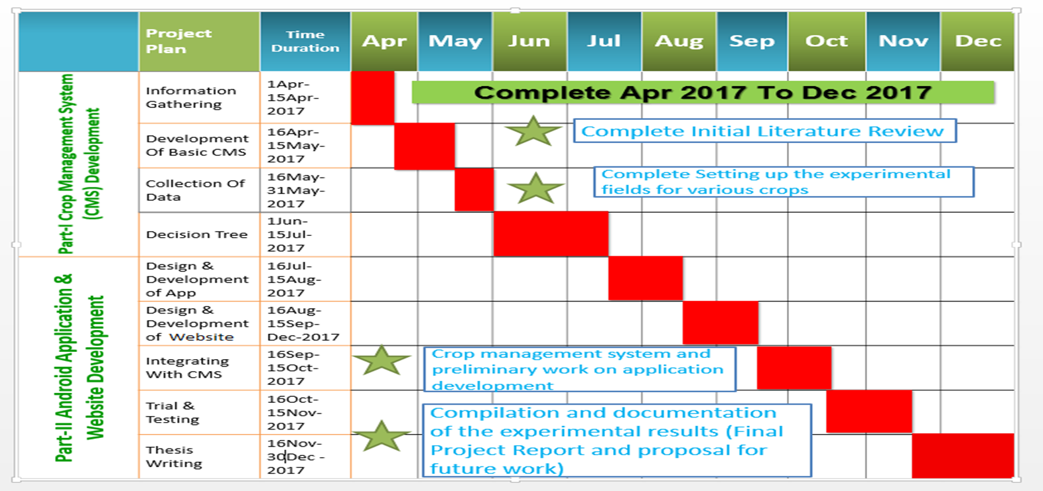
Timeline (1 slide)
How is your work planned according to the time limits starting from the start of the term to the final presentation.
Sample timeline

Slide 9
References (1 – 2 slides)
Here you will mention the references used in your thesis/project.
Sample references
[1] Lydia Uys, “Voice over internet protocol (VoIP) as a communications tool in South African Business”, African Journal of Business Management Vol.3 (3), pp. 089-094, March 2009.
[2] Behrouz A.Forouzan “Data Communications And Networking”, the McGraw-Hill Companies. Inc., 1221 Avenue of the Americas, New York, 2007.

Slide 10
General Guidelines
The maximum number of slides should not be more than 15.
The total time for the presentation is 10 minutes.

